Slide 1
2015-2016 UnionPay International
“40 Selected Tourist Destinations Worldwide”
Marketing Campaign

Slide 2
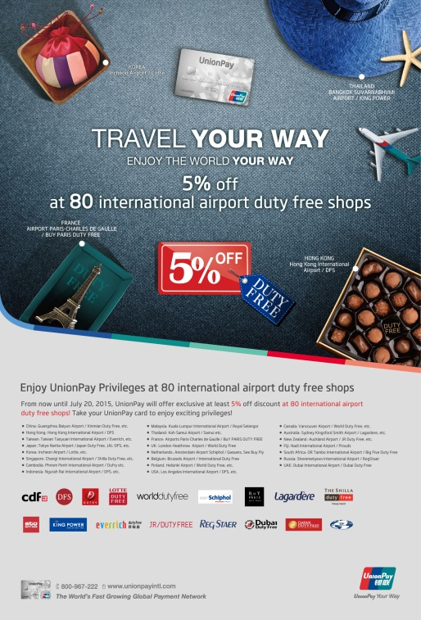
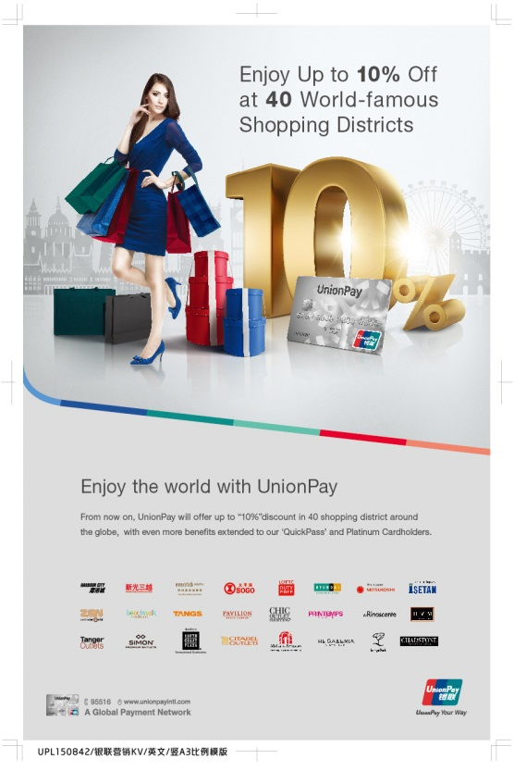
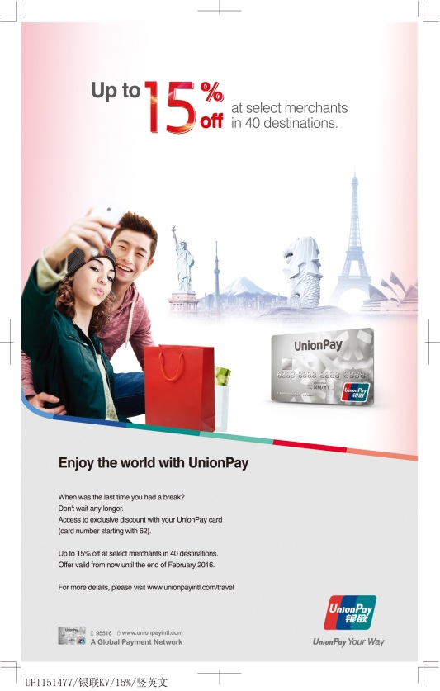
2015 UPI Global Campaigns
Global TOP 80
Airport Duty Free Shops
Global TOP 40
Shopping Districts
Global TOP 40
Selected Tourist Destinations
2015. Q2
2015. Q3
2015. Q4

Slide 3






Latest Background of the Tourist Market
In 2014,number of global cross boarder traveler reach
Percentage of FIT of China outbound tourism reach
During year end, the transaction of travel category increased by
1.13 B
70%
40%
UnionPay global acceptance reach
Number of UnionPay card issued outside of China reach
UnionPay brand recognition in key issuing market reach
150 country/region
50M card
70%

Slide 4






20+
40+
300+ merchants
Campaign Overview
Campaign Period: Nov 20, 2015 – Feb 29, 2015
Offer：Up to 15% off at selected 300 merchants in over 40 destinations worldwide ( including 32 cities and 12 islands )
Target：Worldwide UnionPay cardholders ( card number starting with 62)
UPI Offers you diverse merchant privileges
Countries/Regions
Tourist Cities/Islands
Dining
Tour
Accommodation
Shopping
Transportation
Leisure
4

Slide 5
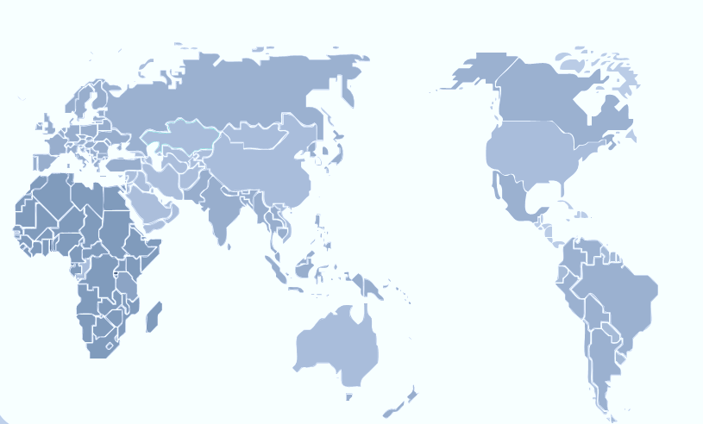
Highlight I
40 Tourist Destinations Covering 5 Continents
Moscow
Toronto
Amsterdam
Hawaii
Paris
Milan
Jeju
Seoul
Tokyo
Madrid
Florence
Dubai
Osaka
Rome
Guam
L.A.
Barcelona
Da Nang
Kyoto
New York
Nha Trang
Taipei
Taichung
Angkor
Hong Kong
Jinmen
Chiang Mai
Phuket
Kaohsiung
Maldives
Kuala Lumpur
Bangkok
Boracay
Johor Bahru
Bali
Tahiti
Sri Lanka
Singapore
Bintan
Seychelles
Cape Town
Mauritius
Sydney
Melbourne
Auckland
Tourist City
Island

Slide 6































Highlight II:
UPI Offers you diverse merchant privileges
Dining
Accommodation
Transportation
Tour
Shopping
Leisure

Slide 7
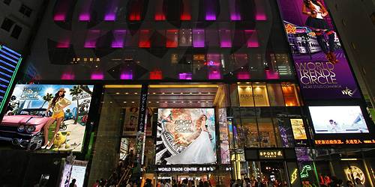
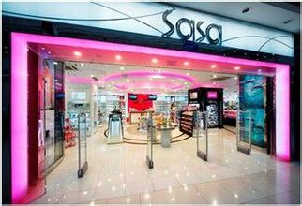
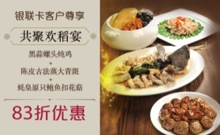


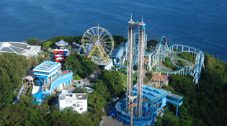
Hong Kong
SHKP Malls:
SASA
Spend over HK 1500 and get HK$50 SHKP Mall Cash Coupon and HK$50 Esso Synergy Fuel Cash Coupon and Extra Free Parking^.
Spend over HK5500 and get HK$200 SHKP Mall Cash Coupon.
Receive extra reward upon purchase of SHKP Mall Cash Coupon valued at HK$3,000
Spend over HK 1500 and get HK$150 coupon.
30% off with Quickpass Payment
Tao Heung Group
Madame Tussauds
Sky100 Hong Kong Observation Deck
Ocean Park
17% off Happy Together Banquet Menu
HK$80 discount on star package ticket
10% off on [day and night] ticket
5% on admission ticket
10% off on park restaurant
7

Slide 8
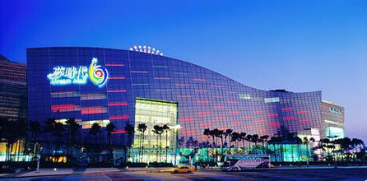
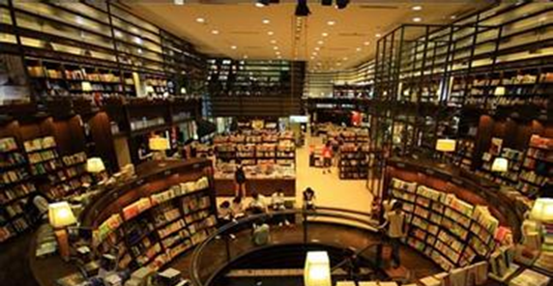
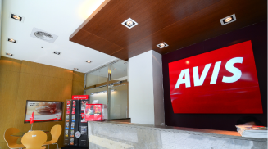



Taiwan
Shin Kong Mitsukoshi
Eslite Bookstore
Free redemption for one Tourist VIP Card of up to 5~10% while shopping.
A Shin Kong Mitsukoshi gift coupon valued NT$ 500 upon spending of NT$ 30,000 or more
NT$ 100 Eslite voucher on cumulative purchase of NT$ 3,000 or more
5% off on purchase of NT$ 1,000 or more; 10% off on purchase of NT$ 3,000 or more.
AVIS
Ding Xian 101
Restaurant
Kaohsiung
E-DA World
Sun Moon Lake Cable
25%-30% off on car rental and 40% off on airport pick up
15% off based on regular price
group ticket discount
Free noodle snack
8

Slide 9
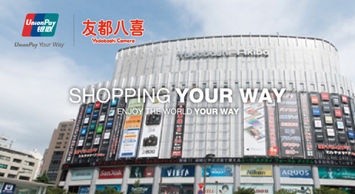
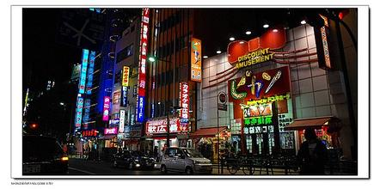

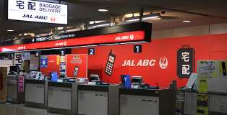


Japan
Yodobashi
Ikebukuro Tobu Department Store
5% off upon spending with UnionPay card
1、Show the official website and get 5% off coupon
2、Spend over ¥5,000 and get a special gift。
Tokyu Hands
Narita/Haneda Airport Wifi Service
Hotel Nikko Kansai Airport
Grand Prince Hotel Kyoto's Restaurant
5% off upon spending with UnionPay card
20% off for Platinum cards
Special price of suite room for Platinum Card
10% discount
for Platinum Card
9

Slide 10
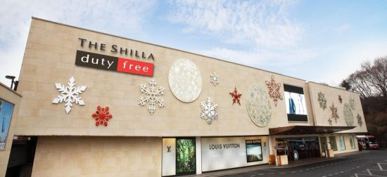



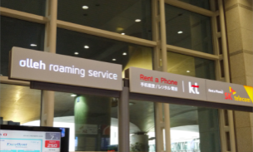
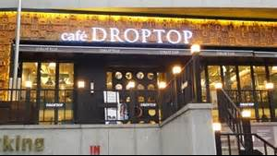
South Korea
Shilla Duty Free Shop
Lotte World
Spend a minimum of US$300 and get a silver membership card of 5-10% off.
10% off upon purchasing 1-Day Pass with UnionPay card;
20% off upon purchasing 1-Day Pass with UnionPay Platinum Card.
Seoul Tourist Shuttle
Incheon Airport Shuttles
KT Roaming Center at Incheon Airport
DROPTOP Coffee
Bar at Jeju Airport
Free travel on shuttle by showing UnionPay cards.
Complimentary T-money transportation card
KRW 2,000 off daily rent of roaming mobile phone
10% off
10

Slide 11
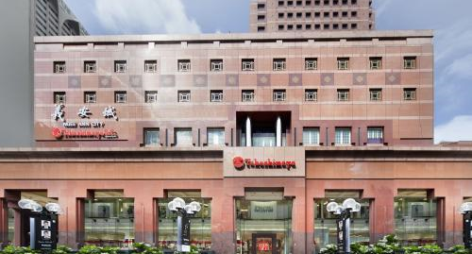
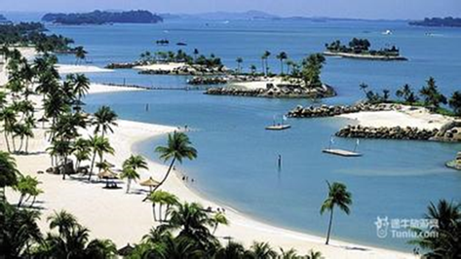
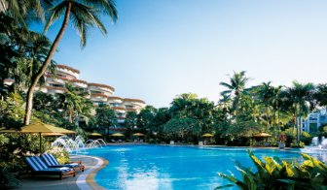
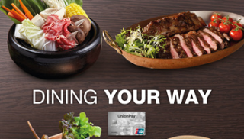
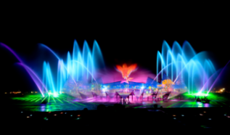
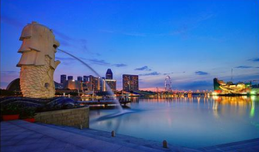
Singapore
Takashimaya Department Store
Sentosa Harbourfront
Free *Tourist Privileges Passport to enjoy a wide array of privileges
spend a minimum of S$500 at participating merchants and redeem Mapletree and Resorts World Sentosa vouchers worth S$50
Shangri-La Hotel
Creative Eateries Restaurants
Sentosa Merlion and Wings
Sentosa Merlion
15% off best available rate, 10% off food and beverage, 10% off treatments
10% off upon spending a minimum of $80
15% off of admission tickets
15% off of admission tickets
11

Slide 12
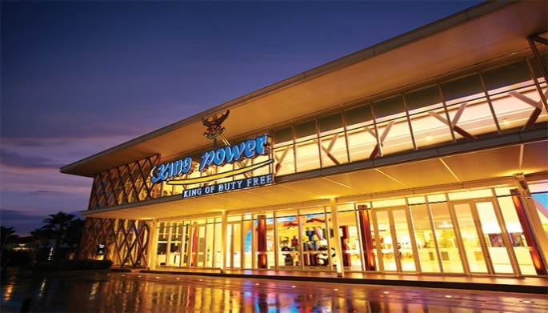
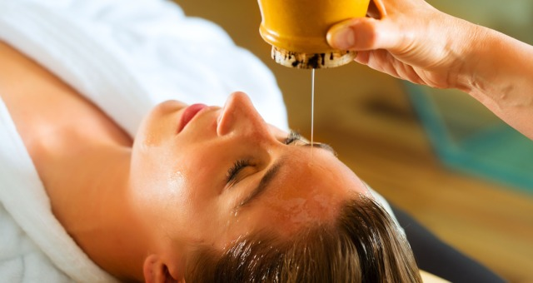

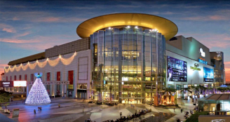

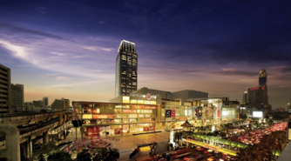

Thailand
King Power Airport Duty Free Shops
Oasis Spa
Buy 10,000 Bht. Get ON TOP Discount 800 Bht.
THB 1,000 discount for any Spa Package value at THB 3,000 or more.
Siam Paragon & Siam Center
Mega Bangna
Central Department Store
Hertz Car Rental
Multiple Privileges by showing UnionPay cards
Spend 4000 THB and receive 200 THB voucher
Spend 4000 THB and receive 200 THB voucher
50% off regular rates
12

Slide 13
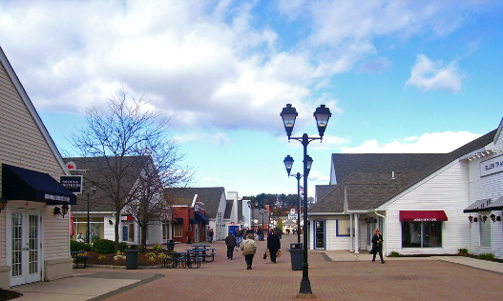
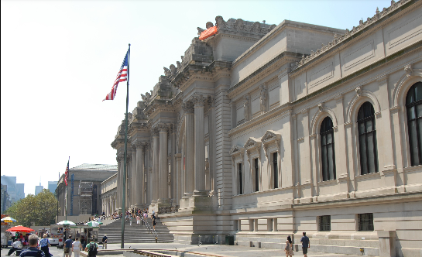


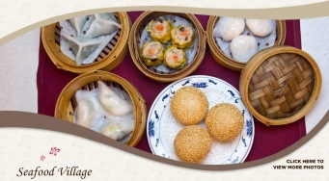

USA
Woodbury Premium Outlets:
The Metropolitan Museum of Art
Get a free VIP Coupon Book at the Information Center of Premium Outlets
get one free pass (recommended admission price $25) at the admissions desks
Westfield Mall
Coral Creek Golf Course
Seafood Village
Budget Car Rental
Receive a $25 gift card with purchase over $500
USD20 off
10% off on main dish
30% off
13

Slide 14
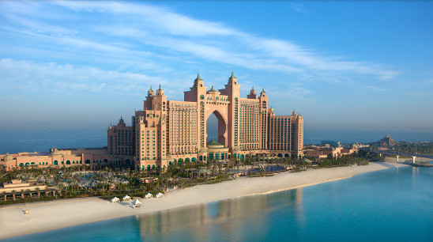
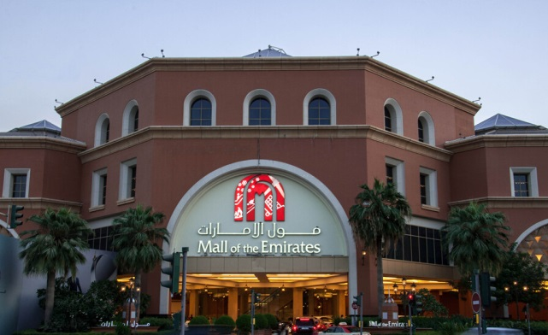
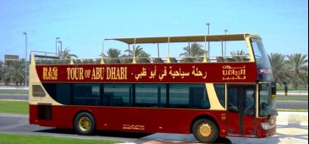


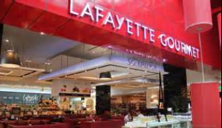
Emirates
21 restaurants in Atlantis The Palm Dubai
Mall of the Emirates
15% discount on hotel restaurant
Spend 5000 AED within one day and get a mall gift card worth 100 AED.
City Sightseeing Dubai
Damac Hotels &Resorts
The Lost Chambers Aquarium
Galleries Lafayette Gourmet
15% Off Best Available Rate
20% discount off for rooms.
25% discount off for spa
20% discount off at Café
15% off
10% restaurant discount
14

Slide 15
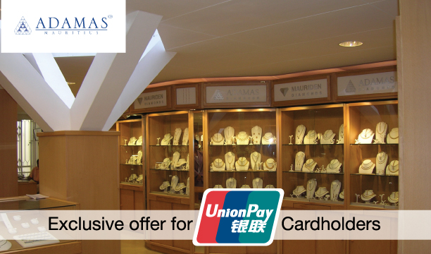
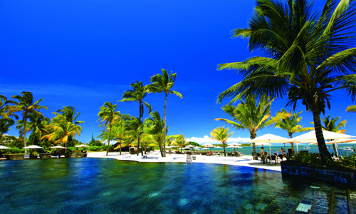
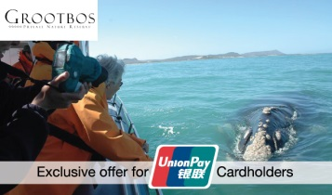



South Africa/Mauritius
Adamas Diamond
White Sand Tours
Diamond card 10% discount for purchase above $ 2000
Platinum UnionPay cardholders:5% discount for purchase above $ 2000
UnionPay cardholders: 5% discount
All UnionPay cards 15% Discount on Magical South package
Cape Town Wine Vinyards
Grootbos Natura Reserve
Tamarina Golf Club
Anahita The Resort
5%-15% off
15% discount on all bookings.
Golf @ 40 Euros for 18 holes
Golf @ 30 Euros for 9 holes
10% discount for a minimum stay of 4 nights

Slide 16
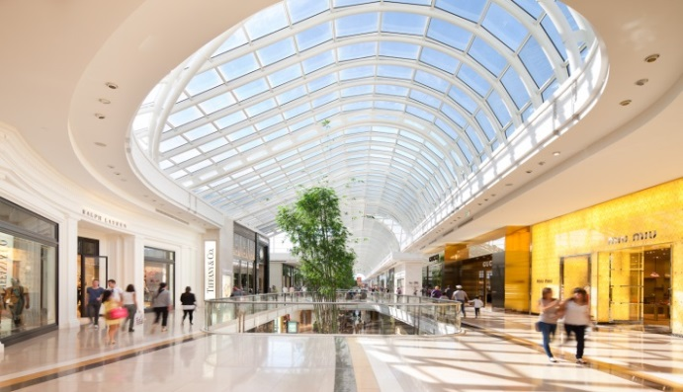





Australia
Chadstone Shopping Centre
Emporium Melbourne
Receive a Free Jurlique gift valued at $120 when presenting a minimum of $400 receipts
spend a minimum of 400 to obtain a 75AUD L’Occitane almond skin care set.
Madame Tussauds
Wildlife Park
Sydney Tower Eye
Sydney Sea Life Aquarium
20%-40% discount on Single Pass tickets
20%-40% discount on Single Pass tickets
20%-40% discount on Single Pass tickets
20%-40% discount on Single Pass tickets
16

Slide 17

Global Network International Brand

